Slide 1
統計學(2)
授課教師：張文珍
wjchang@mail.cgu.edu.tw
校內分機: 3693

Slide 2
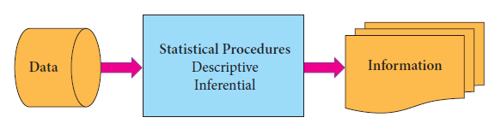
Introduction
Statistics is the science of conducting studies to
Collect, organize, summarize, analyze, and draw conclusions from data.

Slide 3
母體
(Population)
隨機
抽取
樣本
(Sample)
敘述
統計學
整理及展示
母體資料
整理及展示
樣本資料
分析母體資料
➔參數
分析樣本資料
➔統計量
統計學
描述母體特徵
描述樣本特徵
推論
統計學
推論母體特徵

Slide 4
解決統計問題的五大步驟
問題定義
資料收集
各種抽樣方法
中央趨勢量數
分散量數
統計圖表
資料整理
常用統計量
信賴區間
假設檢定
變異數分析(ANOVA)
迴歸分析
資料分析
結論與決策
可信度

Slide 5



Slide 6
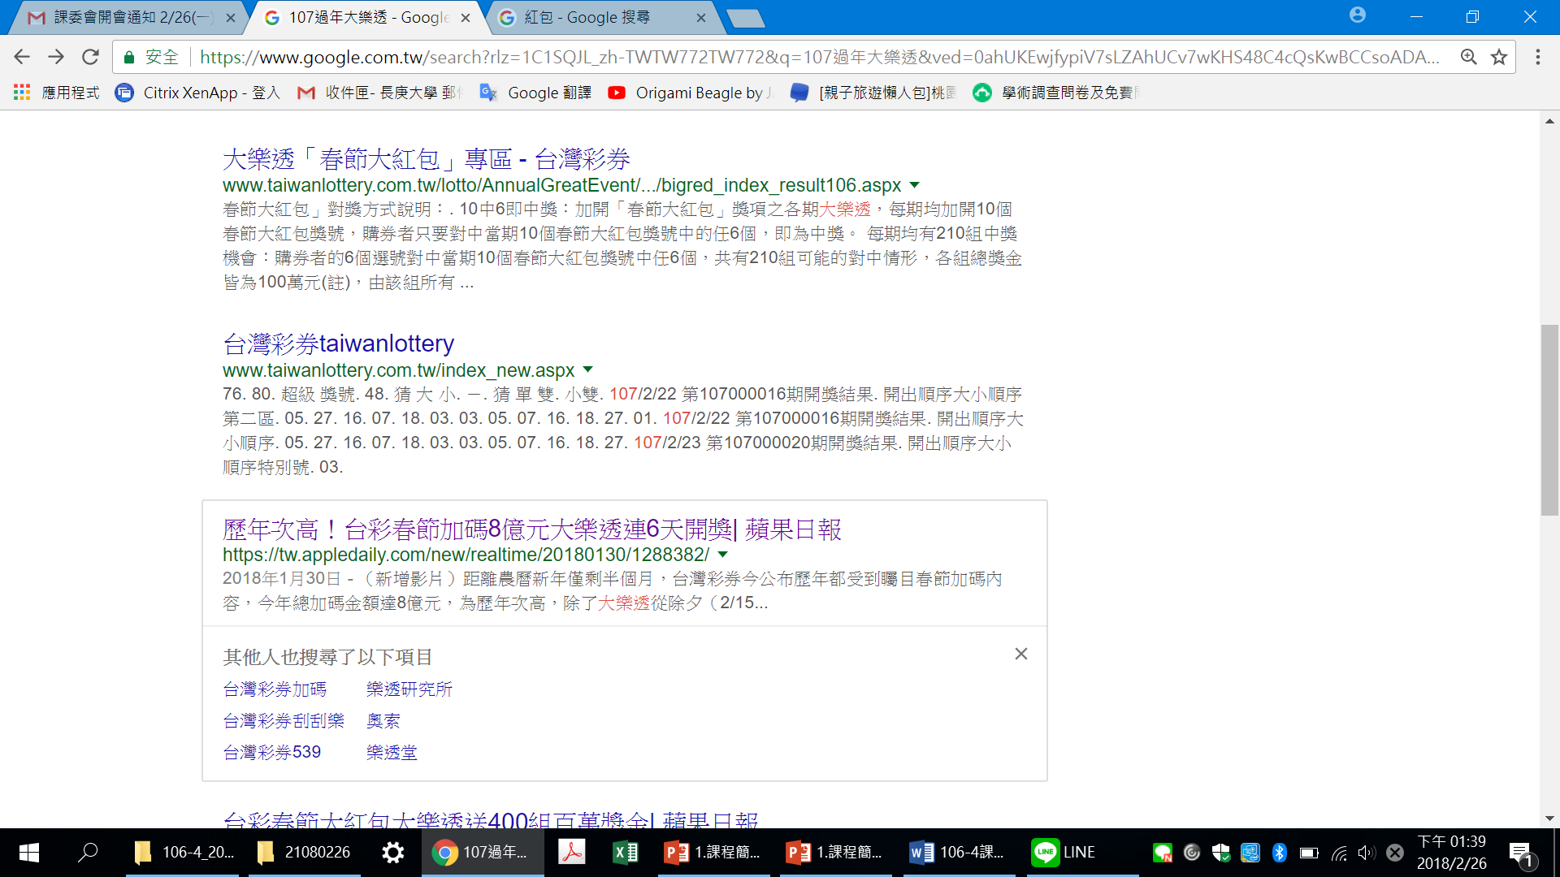



Slide 7


資料來源：https://www.urad.com.tw/16013001/

Slide 8


Slide 9

資料來源：https://www.urad.com.tw/16013001/

Slide 10




Slide 11


Slide 12




Slide 13


Slide 14


Slide 15


課程資訊
科目：統計學(1) (必修)
學分：3學分 / 3小時
上課時間：每週二 9:10~12:00
課程用書：
Allan Bluman,
Elementary Statistics: A Step By Step Approach
10th Edition, Mc Graw-Hill, 2018.
課程講義： ftp://163.25.117.117
帳號&密碼: statistics/ st3693

Slide 16
重要訊息
教學方式
課堂講授及學習成效測驗
評分方式
期中考 20%
期末考 20%
課堂測驗 35%
分組報告 15%
出席表現 10%
考試請假規定

Slide 17
資訊管理系大學部核心能力
社會互動能力：
語言理解與表達能力、溝通協調與團隊合作能力、社會關懷的服務觀、專業倫理、國際觀
問題解決能力：
資料蒐集、分析、整理、自我學習與問題解決能力
系統建置能力：
資訊系統的分析、設計、建置能力與專案的規劃、管理能力
資訊管理知能：
企業資訊管理相關議題的管理知識與技能
跨領域學習：
跨領域知識的學習與整合能力

Slide 18
Assurance of Learning (AoL for BS in IM)
1. Understanding of Information Management
2. Understanding of Information Technology and its applications
3. Able to solve problems
4. Able to communicate effectively
5. Aware of issues in ethics and responsibility

Slide 19
AoL for Statistics(2)
3. Students will be able to solve problems.
3-1 Our students will be able to describe the systematic approach of problem-solving.
3-2 Students will be able to identify problems within a given context and provide feasible solutions.
Criteria:
Understanding the problem context
Capability of grasping a given problem
Capability of finding a feasible solution

Slide 20
週次 | 日 期 | 教 學 進 度 | 教 學 評 量
1 | 2/27 | Course Overview
2 | 3/06 | Review sampling distribution, confidence intervals Confidence intervals for one proportion
3 | 3/13 | Sample size for proportions Confidence intervals for variances and standard deviations | Test (0)
4 | 3/20 | Hypothesis testing overview P-value method for hypothesis testing | Test (1) 確定分組名單
5 | 3/27 | Test for a proportion
6 | 4/03 | Test for a variance, and standard deviation
7 | 4/10 | Testing the difference between two means (dependent samples & independent samples) | Test (2) 確定報告題目
8 | 4/17 | Testing the difference between proportions
9 | 4/24 | Midterm | Midterm

Slide 21
週次 | 日 期 | 教 學 進 度 | 教 學 評 量
10 | 5/01 | Testing the difference between two variances Application of Chi-Squared Tests (I) | 確定問卷
11 | 5/08 | Analysis of Variance (I)
12 | 5/15 | Analysis of variance (II) | Test (3)
13 | 5/22 | Correlation and regression (I)
14 | 5/29 | Correlation and regression (II)
15 | 6/05 | Nonparametric statistics Application of chi-squared tests (I) | Test (4)
16 | 6/12 | Nonparametric statistics Application of chi-squared tests (II)
17 | 6/19 | Project presentation | 期末報告
18 | 6/26 | Final Examination | Final Exam.

Slide 22
Introduction to bell-shaped distribution
Normal Distribution
t-Distribution

Slide 23
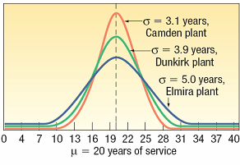
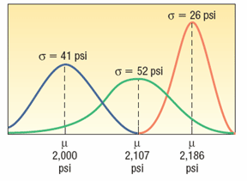
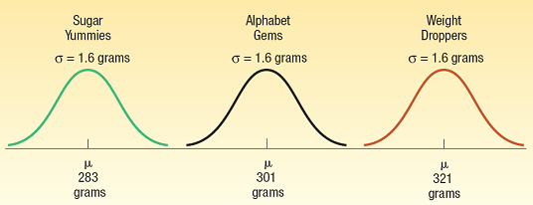
The Normal Distribution - Families

Slide 24
Normal Distributions
The mathematical equation for the normal distribution is:
→ N.D.(μ, σ²) or N.(μ, σ²)

Slide 25
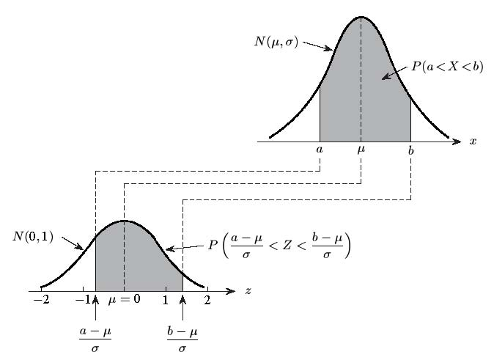
一般常態分配的標準化

Slide 26
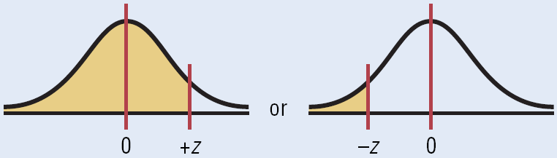
Area under the Standard Normal Distribution Curve
1. To the left of any z value:
Look up the z value in the table and use the area given.

Slide 27
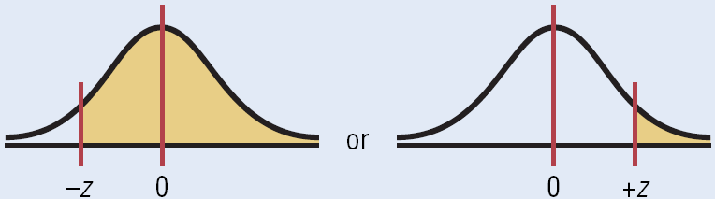
Area under the Standard Normal Distribution Curve
2. To the right of any z value:
Look up the z value and subtract the area from 1.

Slide 28
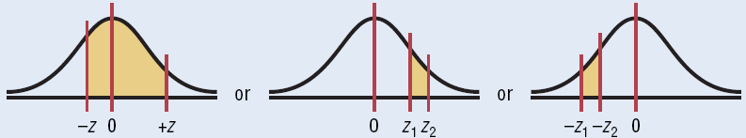
Area under the Standard Normal Distribution Curve
3. Between two z values:
Look up both z values and subtract the corresponding areas.

Slide 29
Exercise
P(-1.2<Z<2.85)=
P(0.23<Z<2.03)=
P(-2.33<Z<-0.50)=
P( |Z|<0.25)=
P(|Z|>1.50)=
P(a<Z<1.58) = 0.3442
a=
P(1.25<Z<b) = 0.0994
b=
P(-2.58<Z<b) = 0.8373

Slide 30
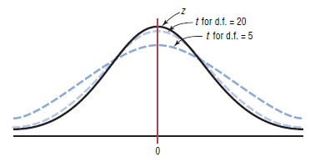
The t distribution
The t family of curves

Slide 31
Degrees of Freedom
The symbol d.f. will be used for degrees of freedom.
The degrees of freedom for a confidence interval for the mean are found by subtracting 1 from the sample size. That is, d.f. = n - 1.
Note: For some statistical tests used later in this book, the degrees of freedom are not equal to n - 1.

Slide 32
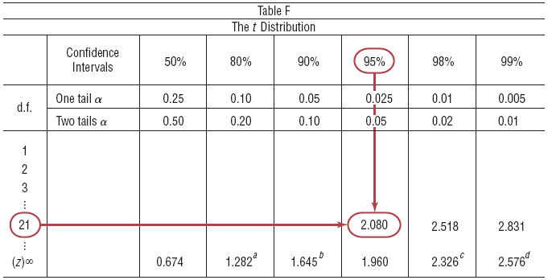
Find the t_{α/2} value for a 95% confidence interval when the sample size is 22.
Degrees of freedom are d.f. = 21.

Slide 33
Exercise
Find the value for each
t_{α /2} and n=18 for the 99% confidence interval for the mean
t_{α /2} and n=23 for the 95% confidence interval for the mean
t_{α /2} and n=15 for the 90% confidence interval for the mean

Slide 34
Hypothesis Tests

Slide 35
Hypothesis Testing
Researchers are interested in answering many types of questions. For example,
Is the earth warming up?
Does a new medication lower blood pressure?
Does the public prefer a certain color in a new fashion line?
Is a new teaching technique better than a traditional one?
Do seat belts reduce the severity of injuries?
These types of questions can be addressed through statistical hypothesis testing, which is a decision-making process for evaluating claims about a population.
Bluman, Chapter 8

Slide 36
Two hypothesis
Two hypothesis: Null & Alternative hypothesis
The null hypothesis, symbolized by H₀, is a statistical hypothesis that states that there is no difference between a parameter and a specific value, or that there is no difference between two parameters.
The alternative hypothesis, symbolized by H₁ or H_{a} is a statistical hypothesis that states the existence of a difference between a parameter and a specific value, or states that there is a difference between two parameters.

Slide 37
統計假設檢定概念
假設檢定模式的建立：
雙尾檢定：
放棄域
接受域
放棄域
α
1
−
α
α
2
2
^
^
^
θ
θ
臨界值
θ
臨界值
1
2
江建良編著，統計學，普林斯頓國際有限公司

Slide 38
統計假設檢定概念
假設檢定模式的建立：
右尾檢定：
接受域
放棄域
1
−
α
α
^
^
θ
θ
臨界值
1
江建良編著，統計學，普林斯頓國際有限公司

Slide 39
統計假設檢定概念
假設檢定模式的建立：
左尾檢定：
放棄域
接受域
1
−
α
α
^
^
θ
θ
臨界值
1
江建良編著，統計學，普林斯頓國際有限公司

Slide 40
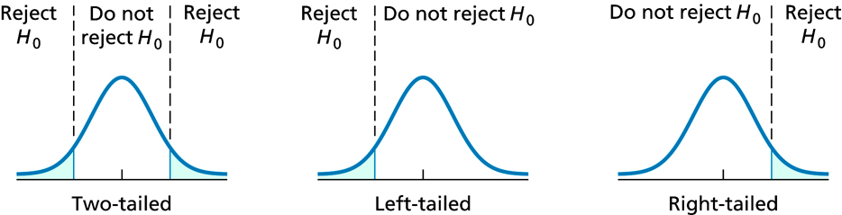
Situation A
A medical researcher is interested in finding out whether a new medication will have any undesirable side effects. The researcher is particularly concerned with the pulse rate of the patients who take the medication. Will the pulse rate increase, decrease, or remain unchanged after a patient takes the medication? The researcher knows that the mean pulse rate for the population under study is 82 beats per minute.
The hypotheses for this situation are
This is called a two-tailed hypothesis test.
Bluman, Chapter 8

Slide 41
Situation B
A chemist invents an additive to increase the life of an automobile battery. The mean lifetime of the automobile battery without the additive is 36 months.
In this book, the null hypothesis is always stated using the equals sign. The hypotheses for this situation are
H₀ : μ ≦36 H₁: μ>36
This is called a right-tailed hypothesis test.
Bluman, Chapter 8

Slide 42
Situation C
A contractor wishes to lower heating bills by using a special type of insulation in houses. If the average of the monthly heating bills is $78, her hypotheses about heating costs with the use of insulation are
The hypotheses for this situation are
H₀ : μ ≧78 H₁: μ<78
This is called a left-tailed hypothesis test.
Bluman, Chapter 8

Slide 43
 | Two-Tailed Test | Left-Tailed Test | Right-Tailed Test
Sign in H₀ | = | ≥ | ≤
Sign in H₁ | ≠ | < | >
Rejection region | In both tails | In the left tail | In the right tail

Slide 44
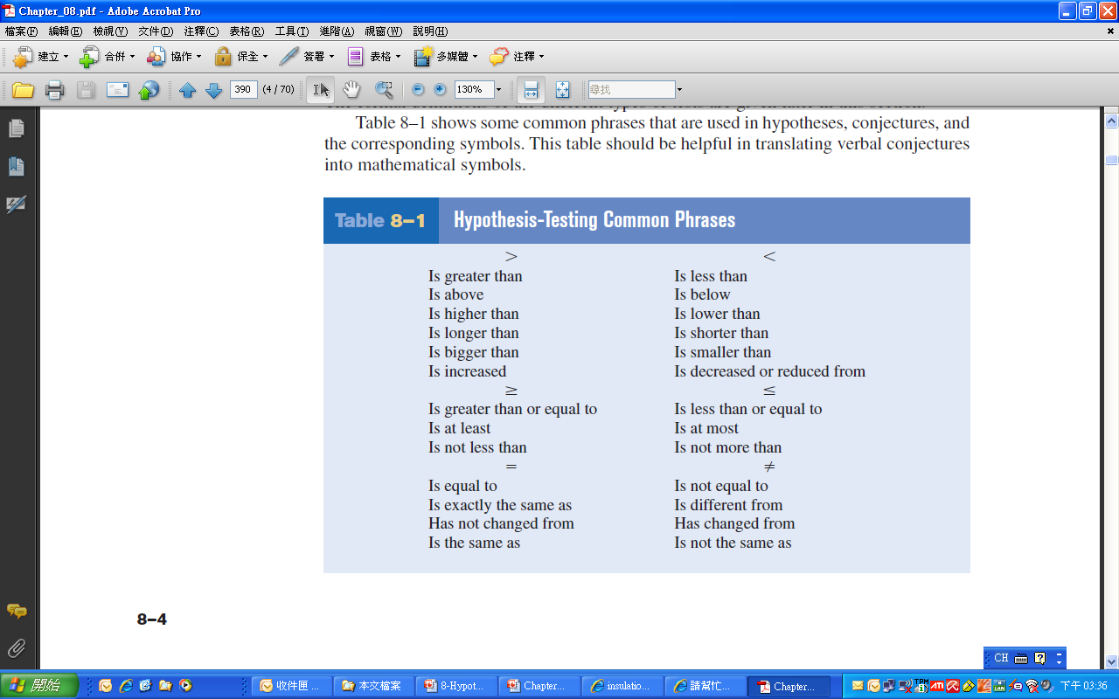

Slide 45
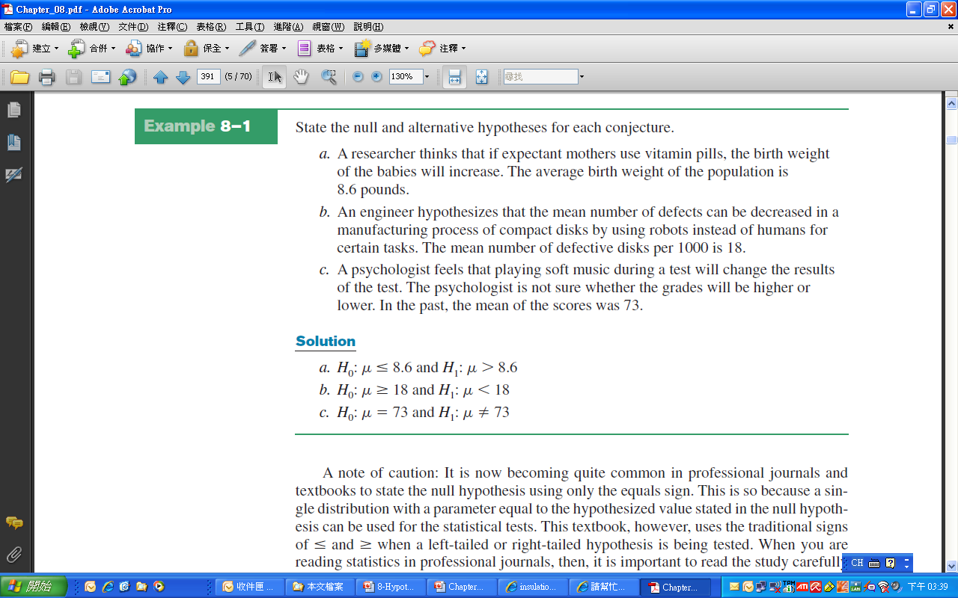
Example 8-1

Slide 46
Hypothesis Testing
After stating the hypotheses, the researcher’s next step is to design the study. The researcher selects the correct statistical test, chooses an appropriate level of significance, and formulates a plan for conducting the study.
Bluman, Chapter 8

Slide 47
Hypothesis Testing
A statistical test uses the data obtained from a sample to make a decision about whether the null hypothesis should be rejected.
The numerical value obtained from a statistical test is called the test value.
Bluman, Chapter 8

Slide 48
Hypothesis Testing
Typical significance levels are:
0.10, 0.05, and 0.01
For example, when α = 0.10, there is a 10% chance of rejecting a true null hypothesis.
Bluman, Chapter 8

Slide 49
Hypothesis Testing
The critical value, C.V., separates the critical region from the noncritical region.
The critical or rejection region, CR. is the range of values of the test value that indicates that there is a significant difference and that the null hypothesis should be rejected.
The noncritical or nonrejection region is the range of values of the test value that indicates that the difference was probably due to chance and that the null hypothesis should not be rejected.
Bluman, Chapter 8

Slide 50
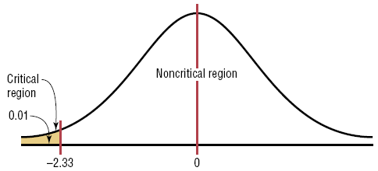
Hypothesis Testing
Finding the Critical Value for α = 0.01 (Left-Tailed Test)
z=
Critical value
Because of symmetry,
z = -2.33 for α = 0.01 (Left-Tailed Test)
Bluman, Chapter 8

Slide 51
Obtain critical value
5% significance level,
(a) Two tailed (b) left tailed (c) Right tailed

Slide 53
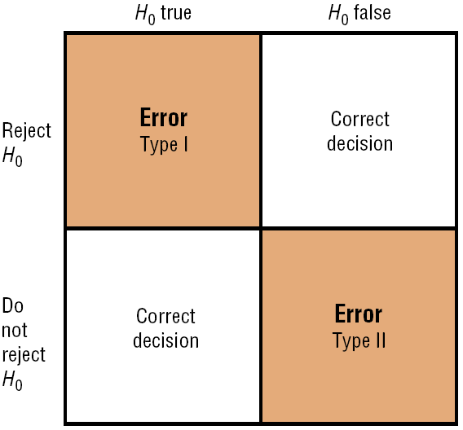
In the hypothesis-testing situation, there are four possible outcomes.

Slide 54
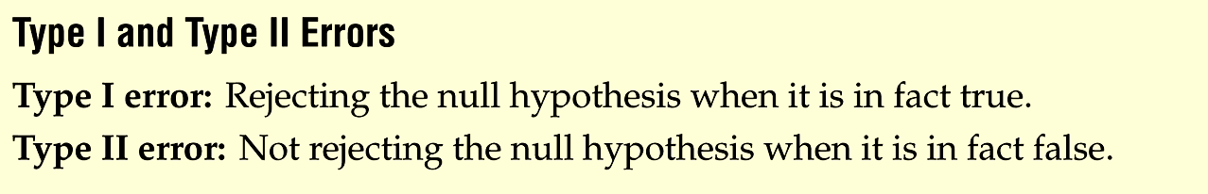
Hypothesis Testing
In reality, the null hypothesis may or may not be true, and a decision is made to reject or not to reject it on the basis of the data obtained from a sample.
Two types of errors
Bluman, Chapter 8

Slide 55
Hypothesis Testing
The level of significance is the maximum probability of committing a type I error. This probability is symbolized by α. That is,
P (type I error) = α =P (H₀ is rejected | H₀ is true).
= P(producer’s risk)
Likewise,
P (type II error) =P (H₀ is not rejected | H₀ is false) = β.
= P(consumer’s risk)
The value of (1–β) is called the power of the test. It represents the probability of not making a Type II error.
Bluman, Chapter 8

Slide 56
統計假設檢定概念
型 I 誤差與型 II 誤差：
型 I 誤差：
P ( I ) = P ( 型 I 誤差 ) = P ( 放棄 H ₀ | H ₀ 為真 )
型 II 誤差：
P ( II ) = P ( 型 II 誤差 ) = P ( 接受 H ₀ | H ₀ 為假 )
決策與兩種誤差、風險、決策與錯誤
真實情況 決策 | H₀ 為真 | H₀ 為假
接受 H₀ 拒絕 H₀ | 決策正確 型Ⅰ錯誤 | 型Ⅱ錯誤 決策正確
顯著水準：
顯著水準α = max P ( 型 I 誤差 ) = max P (I)
1. 當α = 0.01 時，放棄 H ₀，稱為 “非常顯著”
2. 當α = 0.05 之下，放棄 H ₀，稱為 “顯著”
江建良編著，統計學，普林斯頓國際有限公司

Slide 57
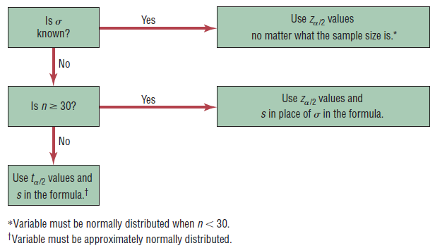
Whether to use z or t
Bluman, Chapter 8
Notes:
57

